Slide 1


HOSPITAL MANGEMENT SYSTEM

Slide 2
Agenda
1
2
3
4
5
Introduction
Requirement
Entity
Relationship
Output

Slide 3


Introduction
Hospital Management System is used to manage all the the hospital operations such as add,view or delete pantients, doctors and staff and the bill associated with them.

Slide 4
The project is completed by: Aayush Kumar Saurabh Ojha
“
”

Slide 5
Requirement
Language
Framework
IDE
Programming Language used for our project is JAVA​
Hibernate is an object-relational mapping (ORM) framework for Java.
IntelliJ IDEA is an integrated development environment (IDE) primarily used for running our project

Slide 6
Entity
The Project include following entities:
Patient
Doctor
Staff
Bill
Payment

Slide 7
Patient
The Patient entity include following attributes:
p_id (Primary Key)
fname
lname
gender
disease
admitstatus
age
phone_no

Slide 8
Doctor
The Doctor entity include following attributes:
1.d_id (Primary Key)
2. d_name
3. qualification
4. specilization
5. availabilit

Slide 9
Staff
The Staff entity include following attributes:
1. s_id (Primary Key)
2. fname
3. lname
4. gender
5. designation
6. age
7. salary

Slide 10
Bill
The Bill entity include following attributes:
1. b_id(Primary Key)
2. basicCharges
3. additionalCharges
4. medicationCharges
5. roomCharges
6. doctorFees
7. totalCharges
8. patient_id(Foreign Key)

Slide 11
Payment
The Payment entity include following attributes:
1. p_id (Primary Key)
2. bill_id (Foreign Key)
3. paymentMethod
4. amount

Slide 12
Relationship Among Entities
Patient and Bill
Each patient can have only one billing record, and each billing record is associated with exactly one patient. (One-to-One)
Patient and Payment
Each patient can have multiple payment records, but each payment record is associated with exactly one patient.(One-to-Many)
Doctor and Patient
A doctor can be assigned to multiple patients, and a patient can be attended by multiple doctors. This relationship is represented by the doctors and patients tables.(Many-toMany)
Staff and Patient
Staff members can be associated with multiple patients, and a patient can interact with multiple staff members. This relationship is represented by the staff and patients tables.( Many-to-Many)
Staff and Doctor
A staff member can work with multiple doctors, and a doctor can have interactions with multiple staff members.( Many-to-Many)

Slide 13
Continued….
Staff and Bill
Each billing record is associated with a staff member who handles the billing process. This relationship ensures that a billing record has a responsible staff member.(One-to-One)
Payment and Bill
Many payment records is tied with one record in the Bill table.(Many- to-One)

Slide 14
ER Diagram
“
”

Slide 15
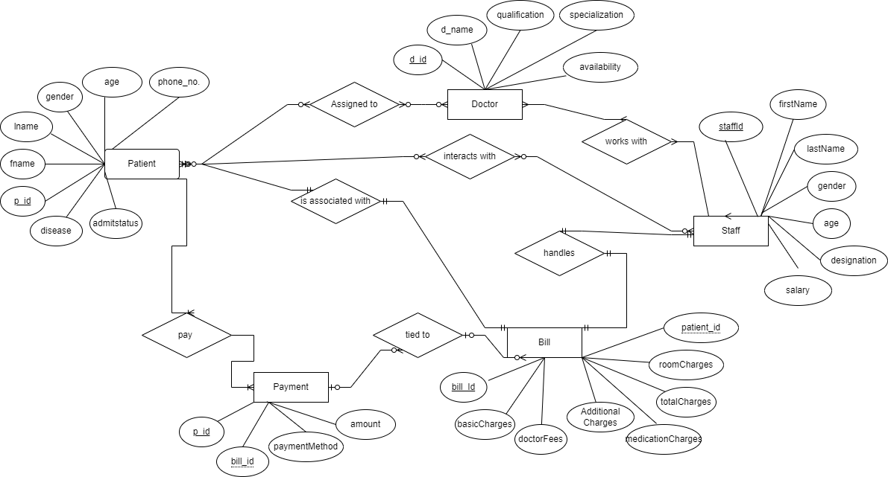

Slide 16
Class Diagram
“
”

Slide 17
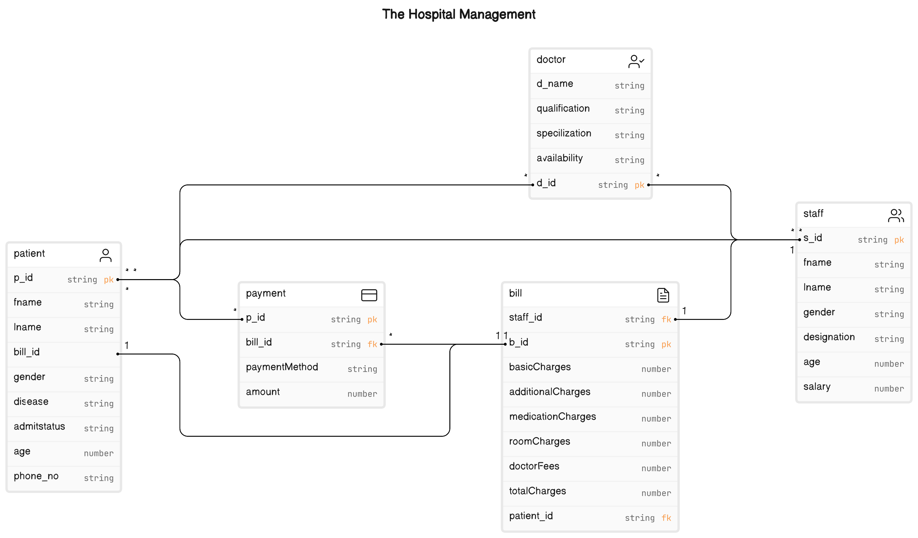

Slide 18
Sequence Diagram
“
”

Slide 19
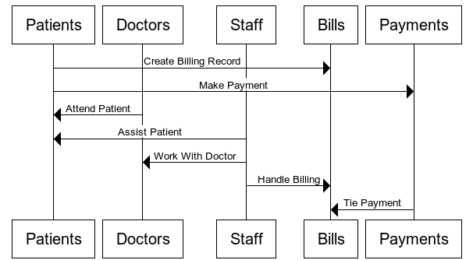

Slide 20
Output
“
”

Slide 21
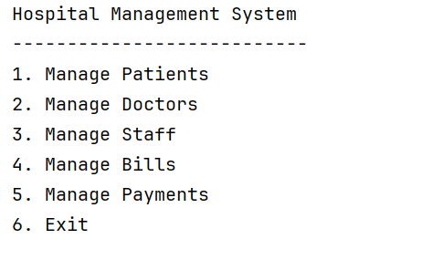
Main

Slide 22
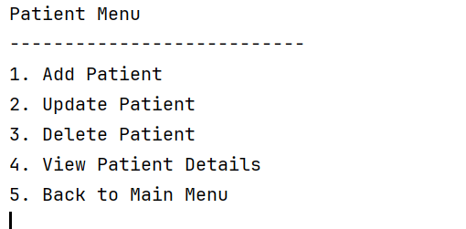
Patient Menu

Slide 23
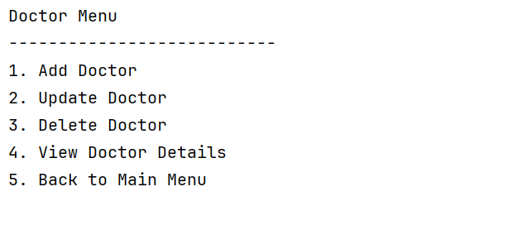
Doctor Menu

Slide 24
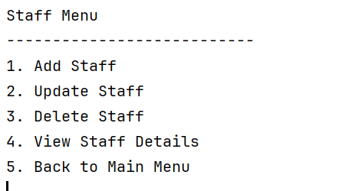
Staff Menu

Slide 25
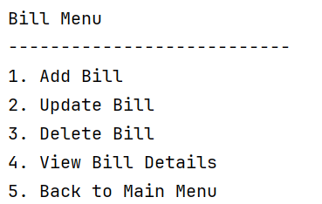
Bill Menu

Slide 26


Thank you

